Slide 1

Rock-Paper-Scissors
A simple yet surprisingly deep game. Played worldwide, from playgrounds to world tournaments.

Slide 2
The Basics of Rock-Paper-Scissors
Winning Rules
Game Flow
Rock crushes scissors
Players show gestures simultaneously
Scissors cuts paper
Draws result in rematches
Paper covers rock
Ensures a clear winner

Slide 3
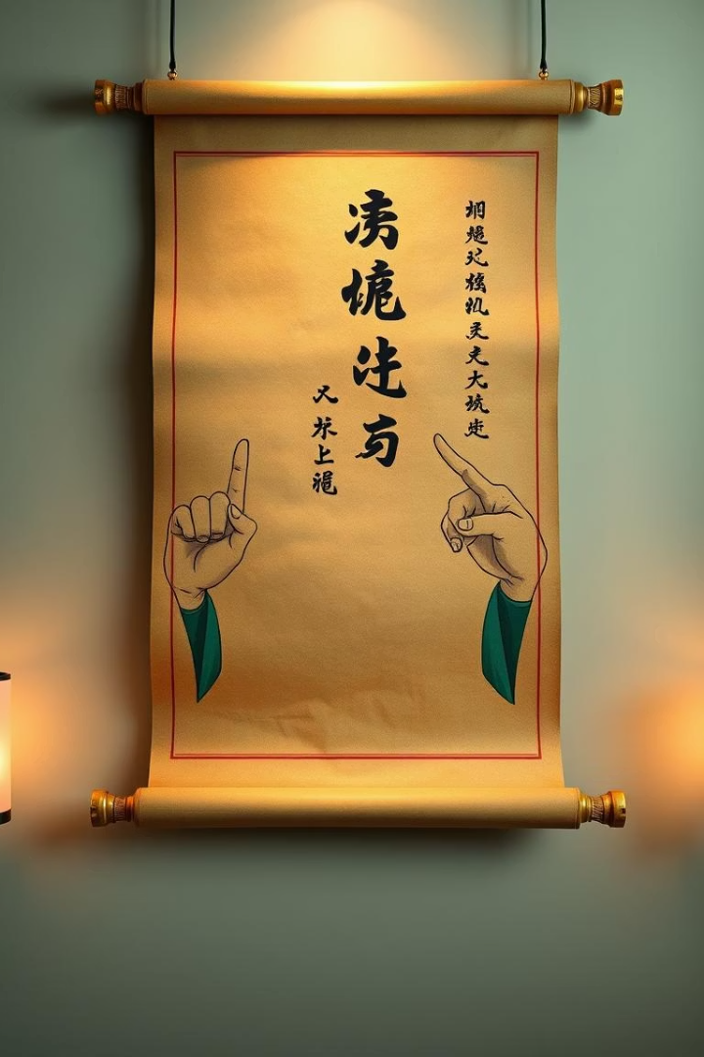
History and Origins
Ancient Roots
Spread Across Asia
Originated in Han Dynasty China, thousands of years ago.
Known as Jan-Ken-Pon in Japan before reaching the West.
Global Recognition
Standardized rules by the 20th century worldwide.

Slide 4

Game Theory and RPS
Zero-Sum Nature
Nash Equilibrium
Exploit Patterns
One wins, one loses; total gains and losses are zero.
Optimal random strategy: 33.3% chance for each throw.
Predict and counter non-random opponent strategies.

Slide 5

Strategic Play
Pattern Recognition
Rock Bias
Spot and use opponent’s throw tendencies.
Many beginners start with rock; use this to your advantage.
Double-Bluff
Anticipate the opponent predicting your own moves.

Slide 6




Psychological Warfare
Predictability
Reverse Psychology
Confidence Projection
Encourage opponents into predictable throws.
Verbal cues to mislead opponents.
Appear strong or weak to influence choices.

Slide 7
Tournament Play
Organized Play
Competitive Events
High Stakes
World RPS Society manages rules and rankings.
National and international tournaments attract many players.
Cash prizes and fame reward top winners.

Slide 8

RPS in Popular Culture
Featured in TV shows like The Big Bang Theory and How I Met Your Mother
Used in movies for quick conflict or decision making
Advertising campaigns leverage RPS for audience engagement

Slide 9

Fun Facts About RPS
Global Popularity
Banking Uses
7 million RPS games played daily worldwide.
Japanese banks used RPS to decide ATM placements.
Creative Variations
Rock-Paper-Scissors-Lizard-Spock popularized by Big Bang Theory.

Slide 10




Resources for Improving Your Game
World RPS Society
Find rules, rankings, and community support.
Online Simulators
Practice against AI to hone skills.
Strategy Guides
Books and articles to deepen psychological understanding.

